Slide 1
PYTHON

Slide 2
MODULE – 2: STATISTICS
ESSENTIALS FOR DATA SCIENCES

Slide 3
AGENDA
After completing this chapter you will be able to answer,
What is Statistics ?
What are its types?
What are the Statistical features?
What is Probability distributions?
What is Dimensionality Reduction?
What is Over and Under sampling?
What is Bayesian Statistics?
How statistics is used in Data Science?

Slide 4
STATISTICS AND ITS TYPES
The study of the collection, analysis, interpretation, presentation, and organization of data.
Key concepts include probability distributions, statistical significance, hypothesis testing, and regression.
TYPES OF STATISTICS:
Descriptive statistics provide information about our sample data by providing us with a concise summary of data.
Inferential statistics uses a random sample of data taken from a population to describe and make inferences about the population. Basically, inferential statistics aims at drawing conclusions (or “inferences”) on populations based on the taken data samples.
Descriptive statistics describes data (for example, a chart or graph) and Inferential statistics allows you to make predictions (“inferences”) from that data.

Slide 5
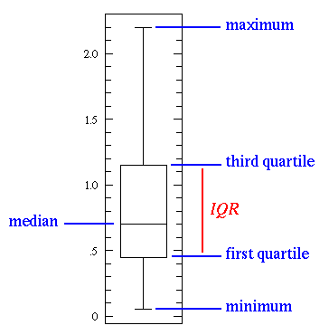
STATISTICAL FEATURES

Slide 6
STATISTICAL FEATURES
Statistical features is probably the most used statistics concept in data science. It’s often the first stats technique you would apply when exploring a dataset and includes things like bias, variance, mean, median, percentiles,
Median is used over the mean since it is more robust to outlier values.
The first quartile is essentially the 25th percentile; i.e 25% of the points in the data fall below that value.
The third quartile is the 75th percentile; i.e 75% of the points in the data fall below that value.
The min and max values represent the upper and lower ends of our data range.

Slide 7
PROBABILITY DISTRIBUTIONS

Slide 8
PROBABILITY DISTRIBUTIONS
We can define probability as the percent chance that some event will occur. In data science this is commonly quantified in the range of 0 to 1 where 0 means we are certain this will not occur and 1 means we are certain it will occur.
TYPES:
Uniform distribution
Poisson distribution
Normal distribution

Slide 9
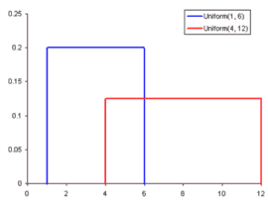
UNIFORM DISTRIBUTION
A Uniform Distribution is the most basic of the 3 we show here. It has a single value which only occurs in a certain range while anything outside that range is just 0. It’s very much an “on or off” distribution. We can also think of it as an indication of a categorical variable with 2 categories: 0 or the value. Your categorical variable might have multiple values other than 0 but we can still visualize it in the same was as a piecewise function of multiple uniform distributions.

Slide 10
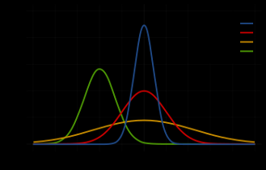
NORMAL DISTRIBUTION
A Normal Distribution, commonly referred to as a Gaussian Distribution, is specifically defined by its mean and standard deviation. The mean value shifts the distribution spatially and the standard deviation controls the spread. The import distinction from other distributions (e.g. Poisson) is that the standard deviation is the same in all directions. Thus with a Gaussian distribution we know the average value of our dataset as well as the spread of the data i.e is it spread over a wide range or is it highly concentrated around a few values.

Slide 11
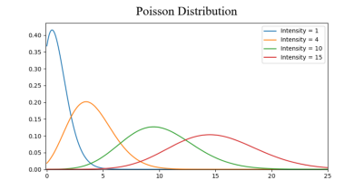
POISSON DISTRIBUTION
A Poisson Distribution is similar to the Normal but with an added factor of skewness. With a low value for the skewness a Poisson distribution will have relatively uniform spread in all directions just like the Normal. But when the skewness value is high in magnitude then the spread of our data will be different in different directions; in one direction it will be very spread and in the other it will be highly concentrated.

Slide 12
DIMENSIONALITY REDUCTION
Projecting the 3D data onto a 2D plane. This effectively reduces the number of points we need to compute.
We can do dimensionality reduction is through feature pruning. With feature pruning we basically want to remove any features we see will be unimportant to our analysis.
The most common stats technique used for dimensionality reduction is PCA which essentially creates vector representations of features showing how important they are to the output i.e., their correlation.

Slide 13
OVER AND UNDER SAMPLING
Over and Under Sampling are techniques used for classification problems.
Under sampling means we will select only some of the data from the majority class, only using as many examples as the minority class has. This selection should be done to maintain the probability distribution of the class.
Oversampling means that we will create copies of our minority class in order to have the same number of examples as the majority class has. The copies will be made such that the distribution of the minority class is maintained.

Slide 14
BAYESIAN STATISTICS
Bayesian Statistics requires us to first understand where Frequency Statistics fails. Frequency Statistics is the type of stats that most people think about when they hear the word “probability”. It involves applying math to analyze the probability of some event occurring, where specifically the only data we compute on is prior data.

Slide 15
USE OF STATISTICS IN DATA SCIENCE

Slide 16
USE OF STATISTCS IN DATA SCIENCE
Design and interpret experiments to inform product decisions
Observation: Advertisement variant A has a 5% higher click-through rate than variant B.
Data Scientists can help determine whether or not that difference is significant enough to warrant increased attention, focus, and investment. They can help you understand experimental results, this is especially useful when you're measuring many metrics, running experiments that affect each other.

Slide 17
USE OF STATISTCS IN DATA SCIENCE
Build models that predict signal, not noise
Observation: Sales in December increased by 5%.
Data Scientists can tell you potential reasons why sales have increased by 5%. Data scientists can help you understand what drives sales, what sales could look like next month, and potential trends to pay attention to.

Slide 18
USE OF STATISTCS IN DATA SCIENCE
Turn big data into the big picture
Observation: Some customers only buy healthy food, while others only buy when there's a sale.
Anyone can observe that the business has 100,000 customers buying 10,000 items at your grocery store.
Data Scientists can help you label each customer, group them with similar customers, and understand their buying habits. This allows you to see how business developments can affect certain groups of the population, instead of looking at everyone as a whole or looking at everyone individually.

Slide 19
USE OF STATISTCS IN DATA SCIENCE
Estimate intelligently
Observation: We have a banner with 100 impressions and 0 clicks.
Data Scientists can incorporate data, global data, and prior knowledge to get a desirable estimate, tell you the properties of that estimate, and summarize what the estimate means.

Slide 20
USE OF STATISTCS IN DATA SCIENCE
Tell the story with the data
The Data Scientist's role in the company is the serve as the ambassador between the data and the company. Communication is key, and the Data Scientist must be able to explain their insights in a way that the company can get aboard, without sacrificing the fidelity of the data.
The Data Scientist does not simply summarize the numbers, but explains why the numbers are important and what actionable insights one can get from these.

Slide 21

Summary
In this course we have learnt about the following
Statistics and its types
The Statistical features
Probability distributions
Dimensionality Reduction
Over and Under sampling
Bayesian Statistics
Use of Statistics in Data Science

Slide 22
THANK YOU!!!

